Slide 1
HOMEWORK 4 Due 4/16 00:00 send to e3

Slide 2
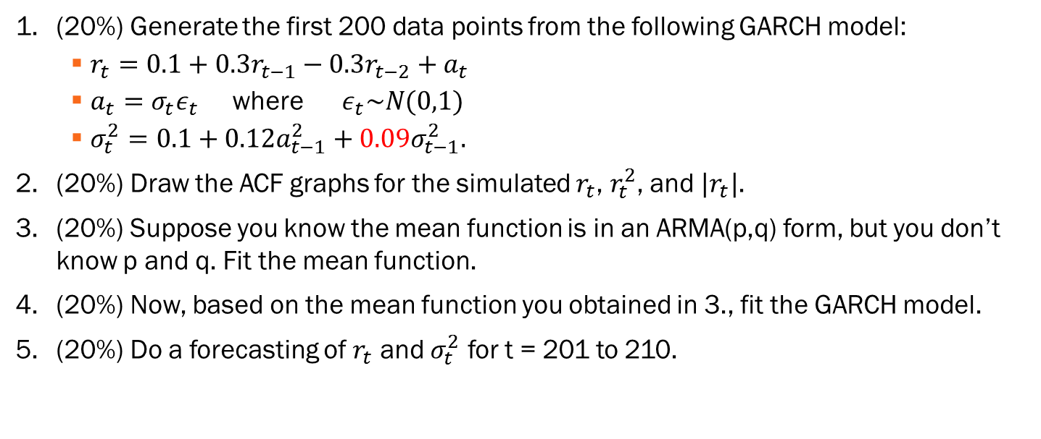
(20%) Generate the first 200 data points from the following GARCH model:
$r_{t}=0.1+0.3r_{t−1}−0.3r_{t−2}+a_{t}$
$a_{t}=σ_{t}ε_{t}$ where $ε_{t}\sim N(0,1)$
$σ_{t}^{2}=0.1+0.12a_{t−1}^{2}+0.09σ_{t−1}^{2}.$
(20%) Draw the ACF graphs for the simulated $r_{t}$, $r_{t}^{2}$, and ${|r}_{t}|$.
(20%) Suppose you know the mean function is in an ARMA(p,q) form, but you don’t know p and q. Fit the mean function.
(20%) Now, based on the mean function you obtained in 3., fit the GARCH model.
(20%) Do a forecasting of $r_{t}$ and $σ_{t}^{2}$ for t = 201 to 210.

